Slide 1
Learning Activity 2.2.5
Image 1
UN Core Pre-Deployment Training Materials 2017

Slide 2
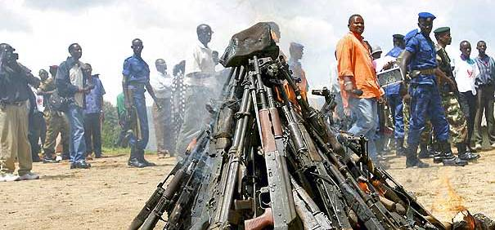
Learning Activity 2.2.5
Image 2
UN Core Pre-Deployment Training Materials 2017

Slide 3
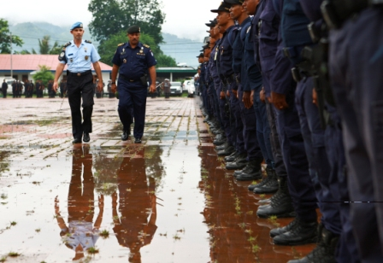
Learning Activity 2.2.5
Image 3
UN Core Pre-Deployment Training Materials 2017

Slide 4
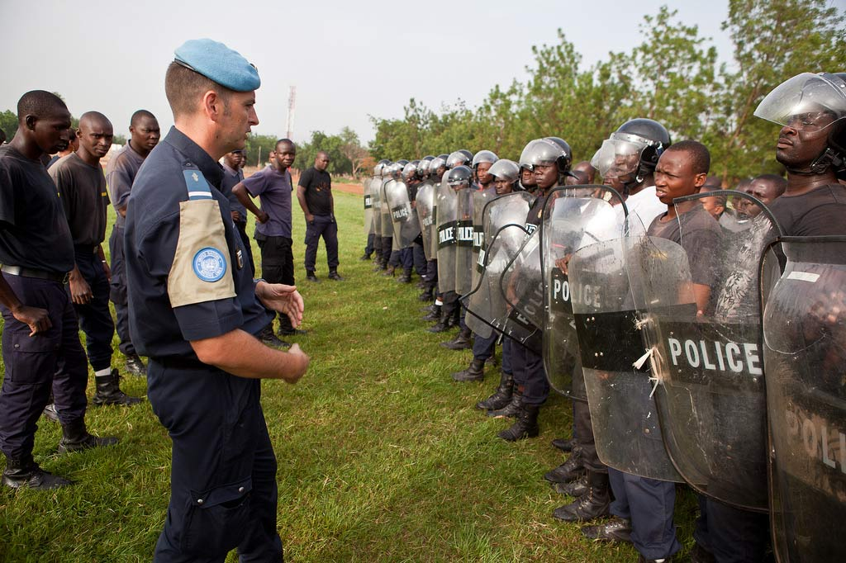
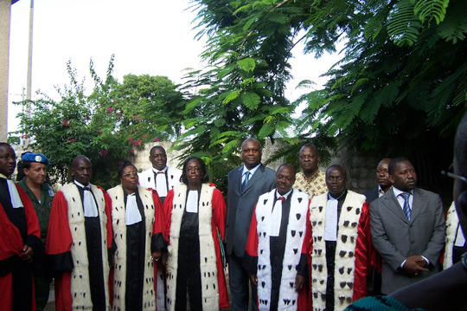
Learning Activity 2.2.5
Image 4
UN Core Pre-Deployment Training Materials 2017

Slide 5
Learning Activity 2.2.5
Image 5
UN Core Pre-Deployment Training Materials 2017

Slide 6
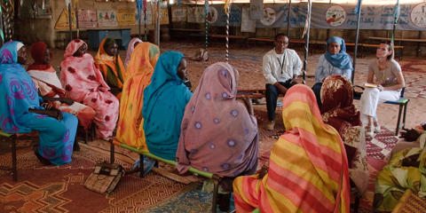
Learning Activity 2.2.5
Image 6
UN Core Pre-Deployment Training Materials 2017

